Slide 1
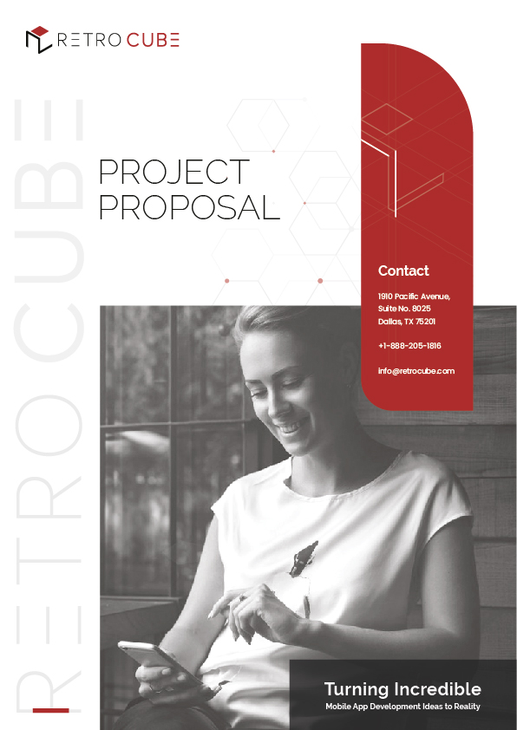
SUBMITTED TO: Elvis

Slide 2

Dear
Elvis,
RetroCube mobile applications are crafted to cater to your business’s speciﬁc demands and to impress your potential customers.
Well aware of the technical aspects of mobile applications, we aspire to bring absolute perfection to your mobile applications.
RetroCube can assure you of our dedication and hard work for your required project. In order to proceed with your project we would like to start with a mutual agreement of the following:
Nothing in this agreement shall be construed or disclosed to any agency, partnership, third party, joint venture, or other similar relationship between the parties.
Neither party will, without prior approval of the other party, use any information in parts, in whole or otherwise disclose the existence and terms of this agreement. Either party may disclose conﬁdential information with the other party in conﬁdence.
We look forward to maintaining a long term business relationship between both the organizations.
Please let us know if you need any support from our end.
In case of any query, feel free to contact us.
Thank you for choosing RetroCube.
Regards,
Team RetroCube

Slide 3
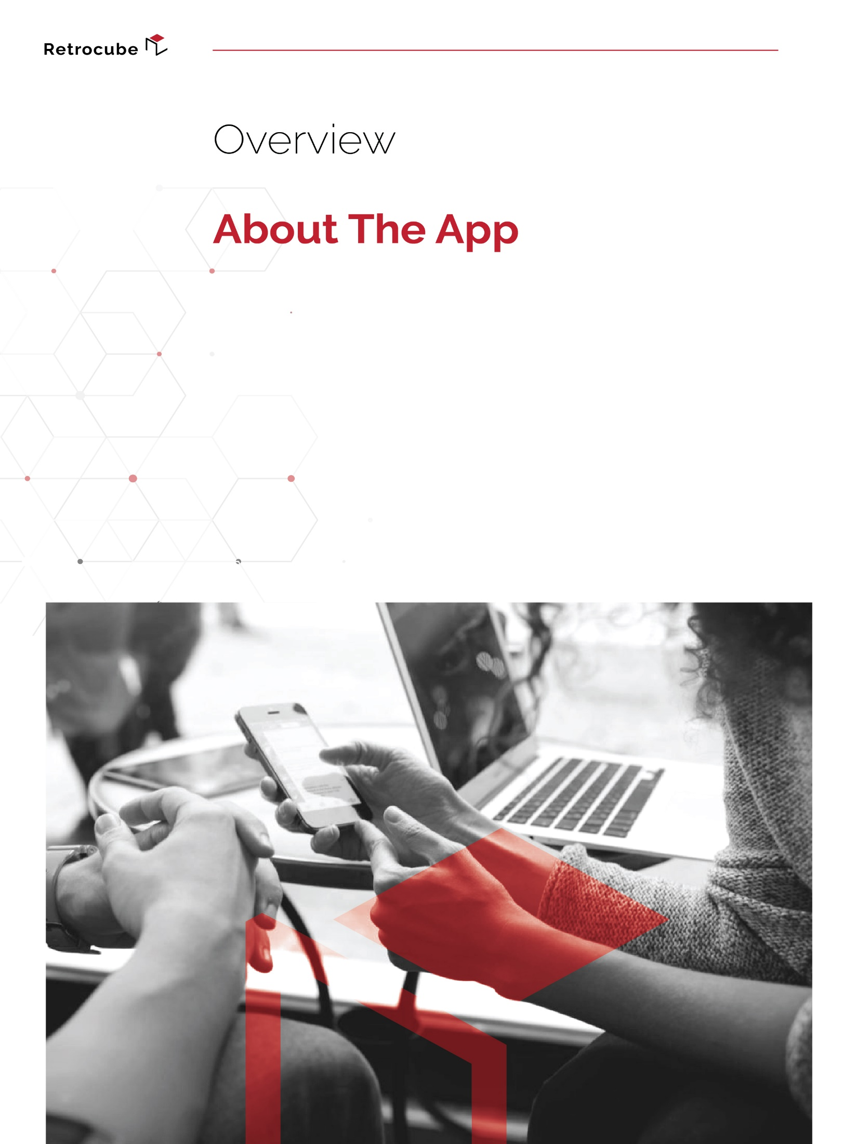
The project is to design & develop a mobile application that will allow users to create a short video, including an image and video, with text and audio files attached to it. Users will be able to choose the duration of their clip and set an image on one side of the screen and a video on the other. Users will have the option to save the video on their device once it is completed.

Slide 4
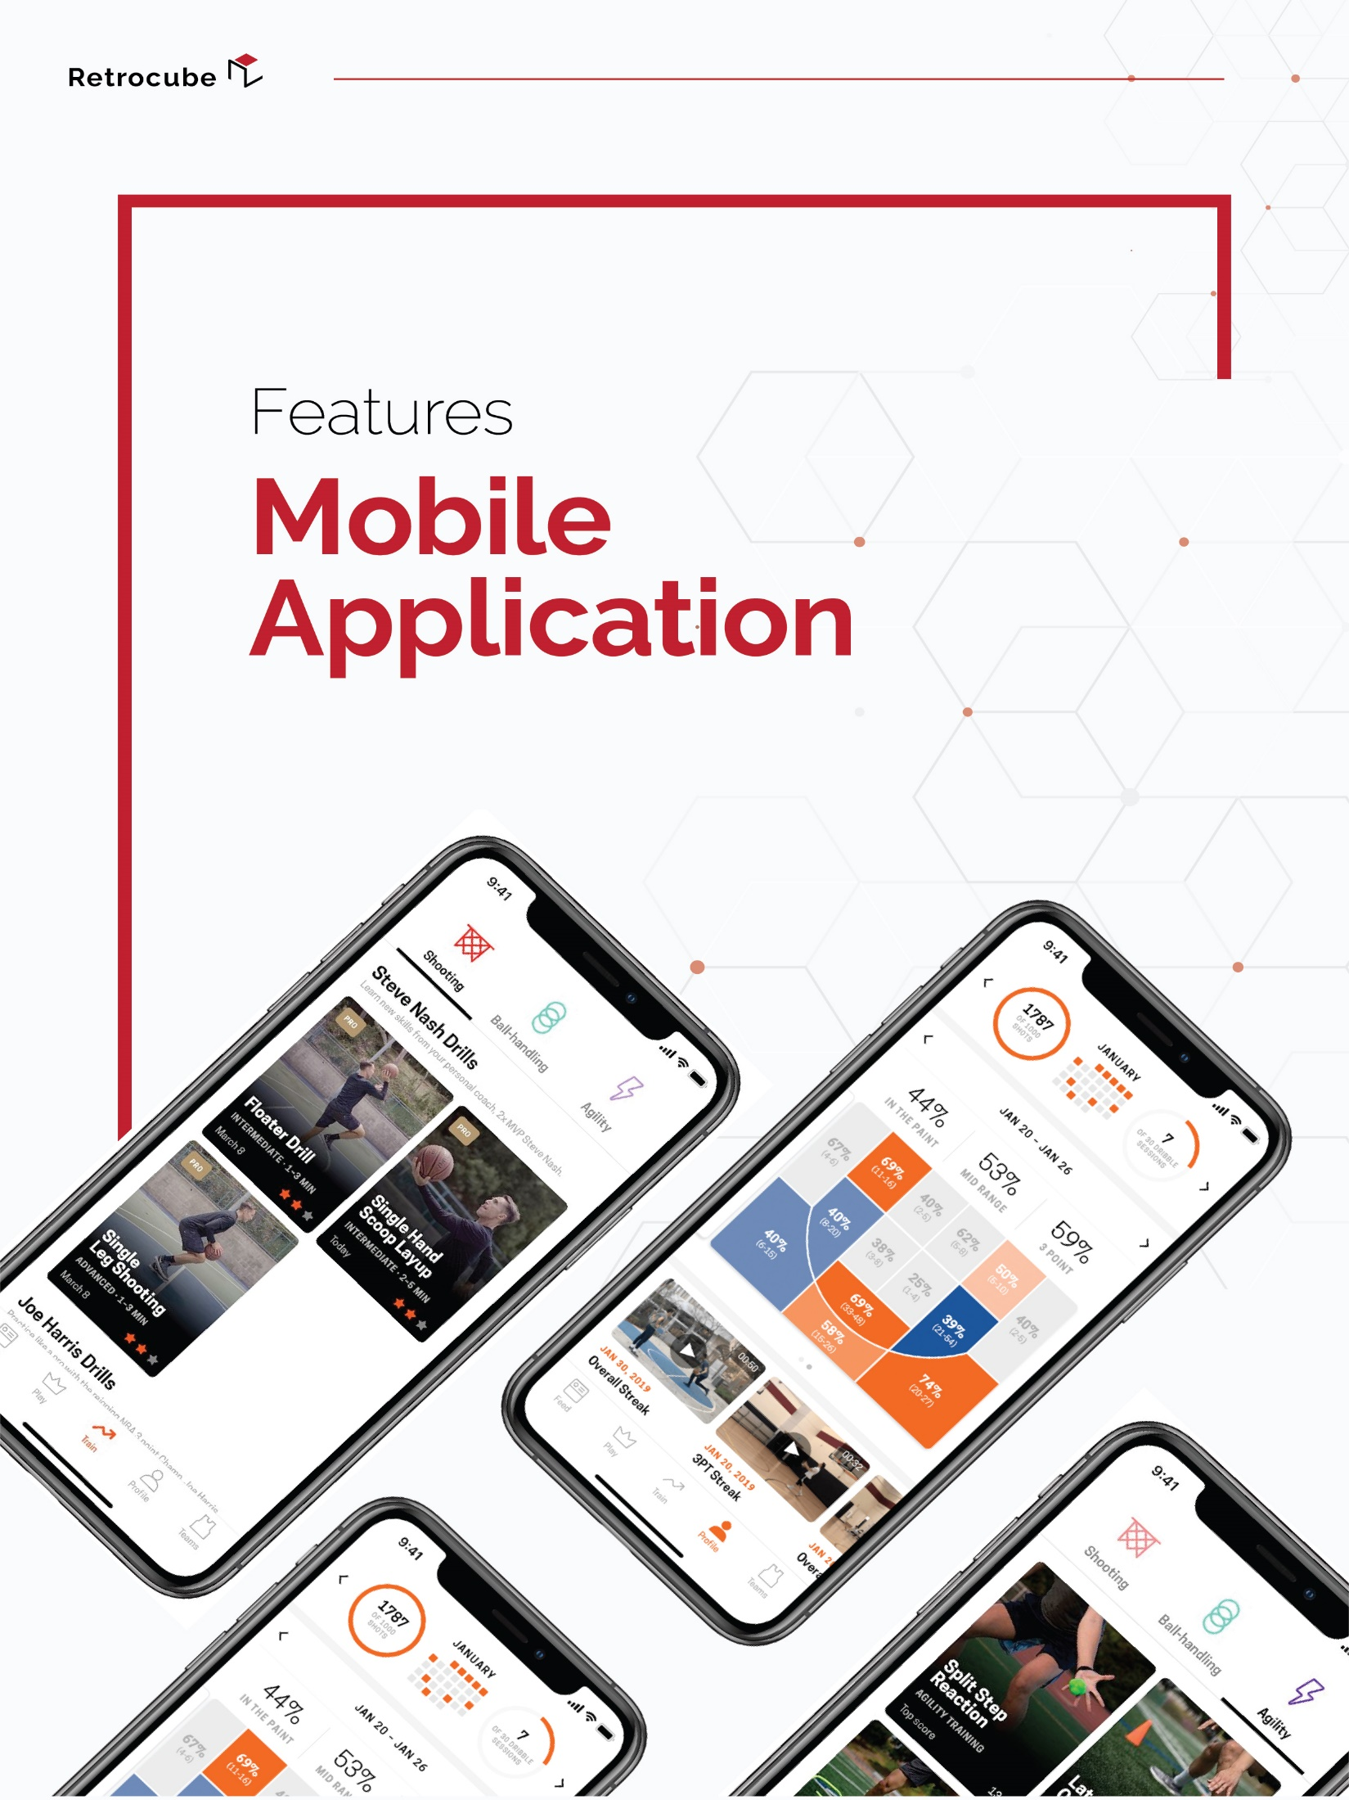
User Type: Users

Slide 5

MOBILE APPLICATION – USERS
Users will have the following features & functionalities available to them on their interface:
| SPLASH SCREEN
The application will start with an appealing and interactive splash screen, which will display the application’s name and logo for 2 - 3 seconds on the mobile application.
| SIGN UP
After the splash screen, users will be re-directed to the Sign-Up or Sign-In screen from where they may opt to Sign Up. Doing so will re-direct them to the Sign-Up screen of the application. Users who choose to Sign-Up will be able to do so using any of the following options:
OPTION A:
Users will be able to Sign Up for the application via a simple Sign Up form, which will comprise of fields such as:
  First & Last Name
  Email Address
  Phone Number
  Password (with See Password feature)
Upon submission of the Sign-Up form, the user will receive a confirmation email for their reference.
OPTION B:
Users can also Sign-Up/log in to the application using the following applicable social media accounts:
    Facebook
    Google
    Apple
| SIGN IN
Users who have registered using the Sign-Up form (option A) will Sign-In into their account by providing their Email Address and Password, while users who have used their social media account to register (option B) will select the appropriate social media to do so. Sign Up/Sign In is necessary to use the application.

Slide 6
MOBILE APPLICATION – USERS
| MAIN SCREEN
The main screen will be displayed after the splash screen, or if the users are not already signed in, then it will be displayed to them after they sign in on the application. On the main screen, users will be displayed their previous projects and the option to start a new project. For the new project, there will be three options for the duration of the clip, i.e., 37 seconds, 1 minute, and 1 minute 37 seconds. Once they have made their choice, they can proceed to the next screen by tapping on the ‘Next’ button. The users will then be prompted to provide access to their phone’s storage to use images/videos within the application.
CLIP CREATION: The users will be displayed a frame with two sections. They can choose to upload an image in one section, and a video in the other one. Once added, the app will display the video timeline at the bottom of the screen based on their chosen time duration. They will also have the option to add text or audio files to the video.
TEXT: For text, they will be displayed an input box to enter their text. They can choose the fonts (10 options), color (12 options), placement of the text, and size of the text (5 options). After specifying the details, it will be added to the video with the duration slider at the bottom below the video timeline. Users can slide the slider to define the starting and ending points for the selected text being displayed, along with the option to delete the text box. They can also add multiple text boxes in a single video clip.
AUDIO: The application will include tracks added by the Super Administrator. However, users can also add any track from the storage of their phone. Once added, it will be displayed as a slider at the bottom of the screen with the video timeline. Users can move the slider to set the starting and ending points of the audio. They can also split the audio file from any point by tapping on the split button from the bottom menu at their desired point. Once tapped, the audio file will split into two parts. Users can delete the audio file or parts by selecting their frame and tapping on the delete button from the bottom menu.
At any point, users will have the option to download the video to their phones. The video will be autosaved after every change made to it. It will be displayed in the ‘My Projects’ section of the application.
NOTE: Compatible extensions of the soundtracks is to be decided by the client.

Slide 7
MOBILE APPLICATION – USERS
Other options will redirect the users to the following sections of the application:
    My Projects
    My Account
    Static Content
| MY PROJECTS
This section will display the previous projects created by the users. Upon tapping on any project, they will be redirected to the editing screen for the respective project. They can either edit the project or download the clip into their phones. The progress of each project will be autosaved after every change is made to it.
| MONETIZATION
The monetization module will consist of the following aspects:
ADVERTISEMENTS: The application will be integrated with the Google AdMob API for monetization purposes. The ads will be displayed in a specific section of the mobile application. The Super Administrator will be able to manage the ads from the control panel of Google Ads.
AD-FREE: The application will include an in-app purchase functionality, allowing the users to use an ad-free application by paying the fee. The application will use Google and Apple pay to make the payments.
| MY ACCOUNT
Users will be able to view and manage their accounts. Their account will also comprise of the following:
  My Profile
    This includes their Name, Profile Picture, Phone Number, Username, Email Address, etc.
    Password & Change Password
  Notification Settings
  Sign Out

Slide 8
MOBILE APPLICATION – USERS
| NOTIFICATIONS
This feature will allow the users to get notifications from the application about the application's important events. A Third-Party service may be required to achieve the push notifications functionality.
| STATIC CONTENT
The application will include a dedicated section to display the static content within the application, such as the FAQs, Privacy Policy, Terms & Conditions, etc.

Slide 9
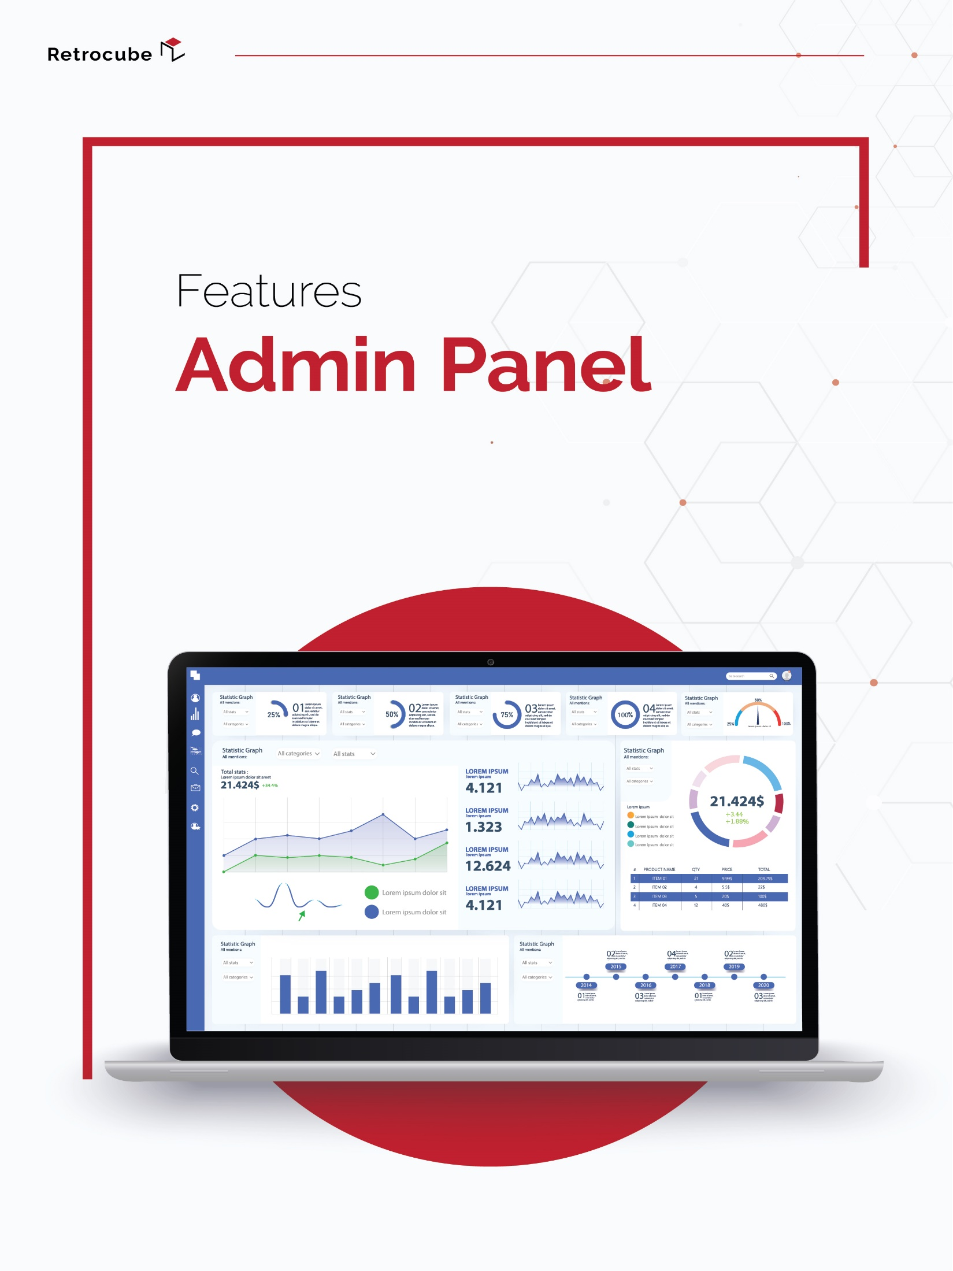

Slide 10

ADMINISTRATIVE WEB PANEL
The Super Administrator will have the following features & functionalities:
| SIGN IN
The Super Administrator will be registered into the system by the development team and can sign in to their interface by entering their credentials; after signing in, the Super Administrator will have the option to change their password whenever they want.
| USERS MANAGEMENT
The Super Administrator will be able to manage the users of the application, with the following functionalities:
  View List of Users
    View Details
  Add Users
  Edit Users
  Delete Users
  Activate/Deactivate Users
| SOUNDTRACK MANAGEMENT
The Super Administrator will be able to manage the soundtracks uploaded with the following functionalities:
  View List Soundtracks
    View Details
  Add a Soundtrack
    Add Name
    Add File
  Edit Soundtracks
  Delete Soundtracks
  Activate/Deactivate Soundtracks
NOTE: Soundtrack extensions are to be decided by the client.

Slide 11
ADMINISTRATIVE WEB PANEL
| STATIC CONTENT MANAGEMENT
The Super Administrator will be able to manage the Static Content (FAQs, About Us, Terms & Conditions, etc.) on the application, with the following functionalities:
View Content
Edit Content

Slide 12
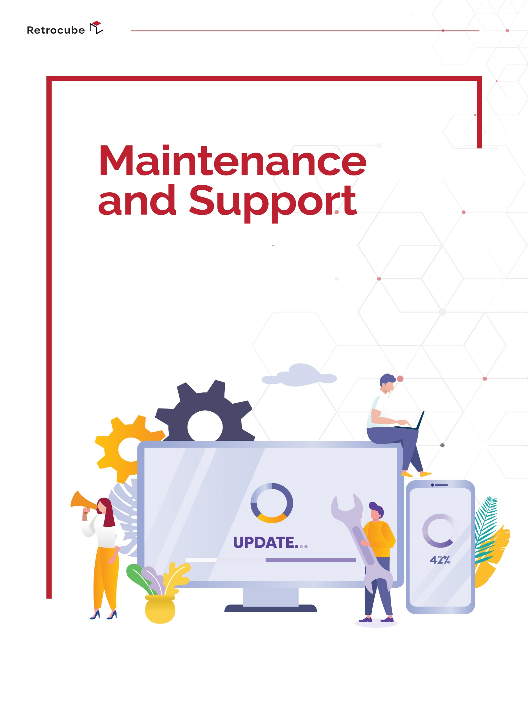

Slide 13
APPLICATION MAINTENANCE & SUPPORT
Team RetroCube will also offer the following maintenance & support of the mobile application for 100 days after the development.
| APPLICATION MONITORING
We strive to deliver a flawless customer experience by maintaining the performance of your mobile apps. Our app development professionals would regularly conduct:
  Performance Monitoring
  Usability Review
  App Crash Monitoring
  Source Code Repository & Versioning
  Renewal Monitoring
  App Store Management & Monitoring
  OS & Device Updates
  App Feedback Monitoring
  3rd Party Integration Updates
| APPLICATION MAINTENANCE PROCESS
We will do the following maintenance processes for the application:
Application Testing & Support
Troubleshooting & Bug Fixing
Application Enhancement & Improvements
| SUPPORT
Each of your concerns or confusions will be addressed satisfactorily by our end-to-end customer support services. We’ll also support our client with:
App deployment on App Stores

Slide 14
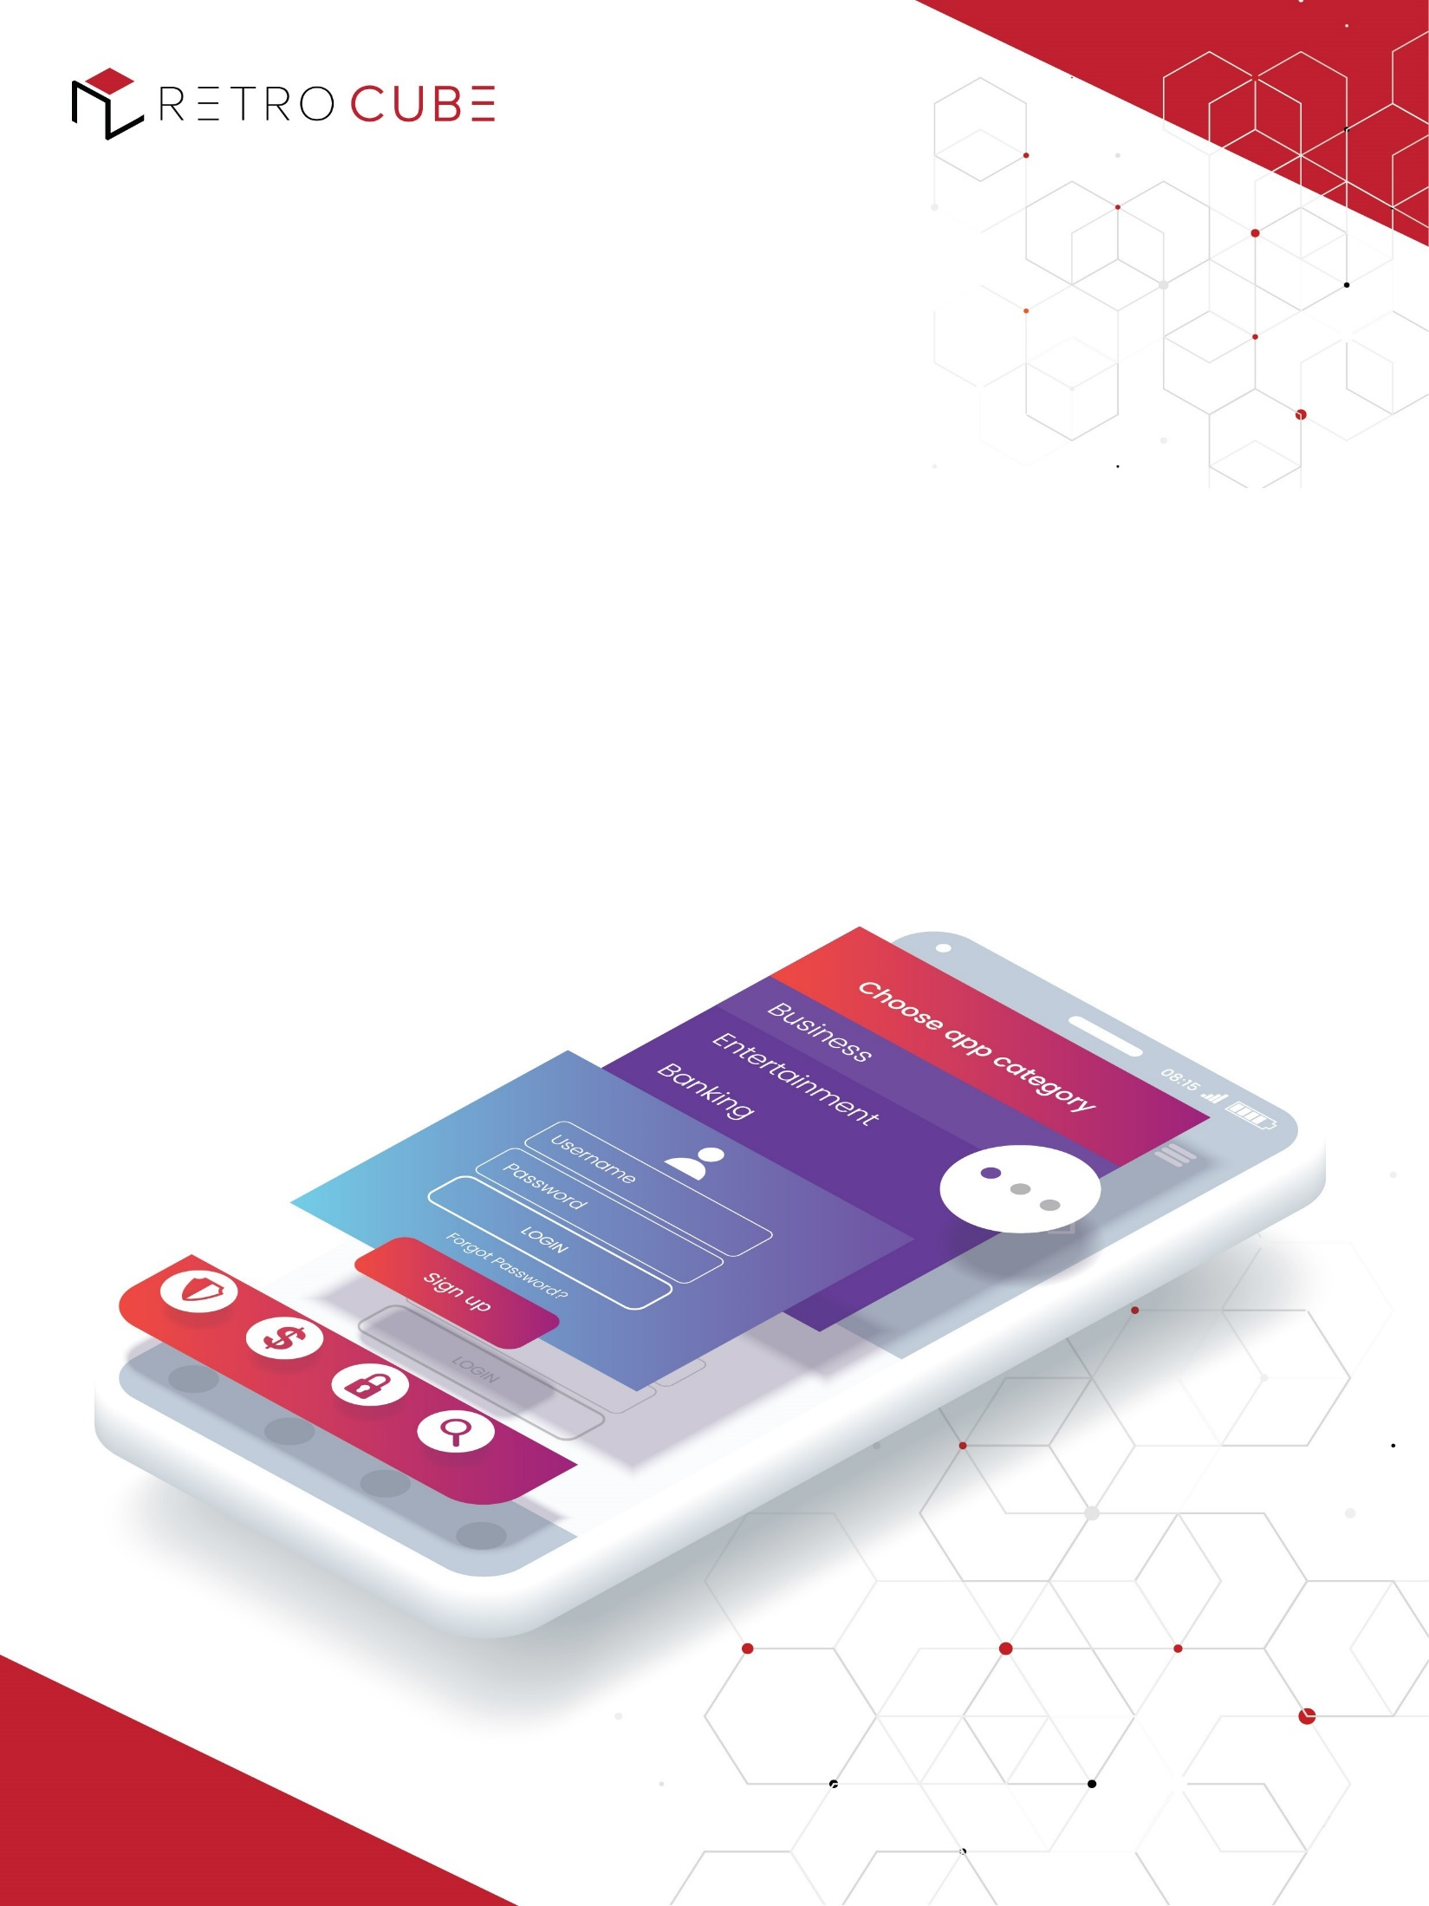












APPLICATION PLATFORMS
DEVELOPMENT TOOLS
iPhones
Android Phones
Web (Administrative Panel)
Visual Code
PHP Storm
PROGRAMMING LANGUAGE
OPERATING SYSTEM
React Native
HTML
CSS
PHP
Java Script
iOS 11 up to latest
Android Oreo 8.0 up to latest

Slide 15
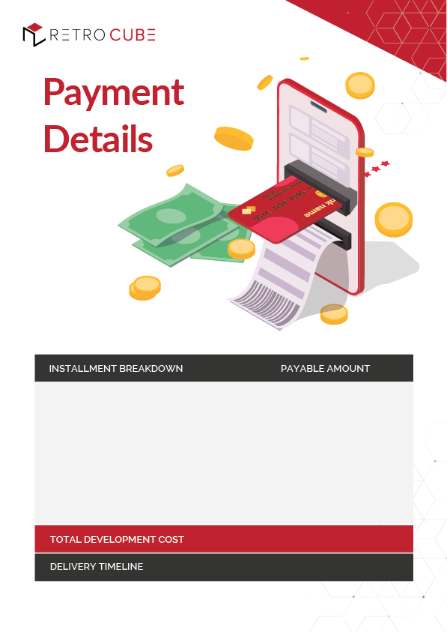
Project Initiation
Design & UI
App Development: Alpha
App Development: Beta
$ 9,750
$ 9,750
$ 9,750
$ 9,750
$ 39,000
160 - 180 Working Days
Note: The above-mentioned estimates are exclusive of the App design, publishing, & Apple/Google Store approval.

Slide 16
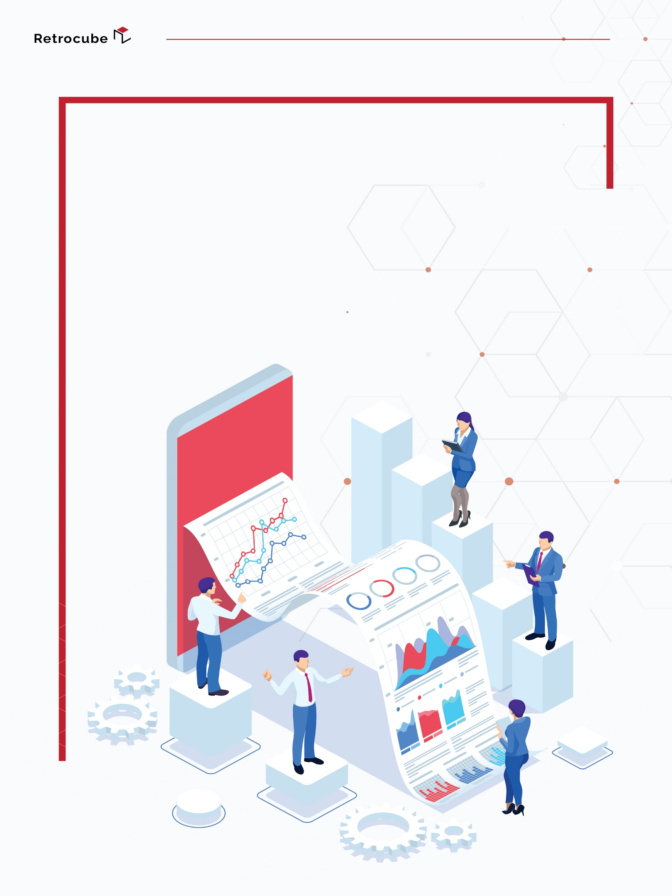
Market
Analysis

Slide 17
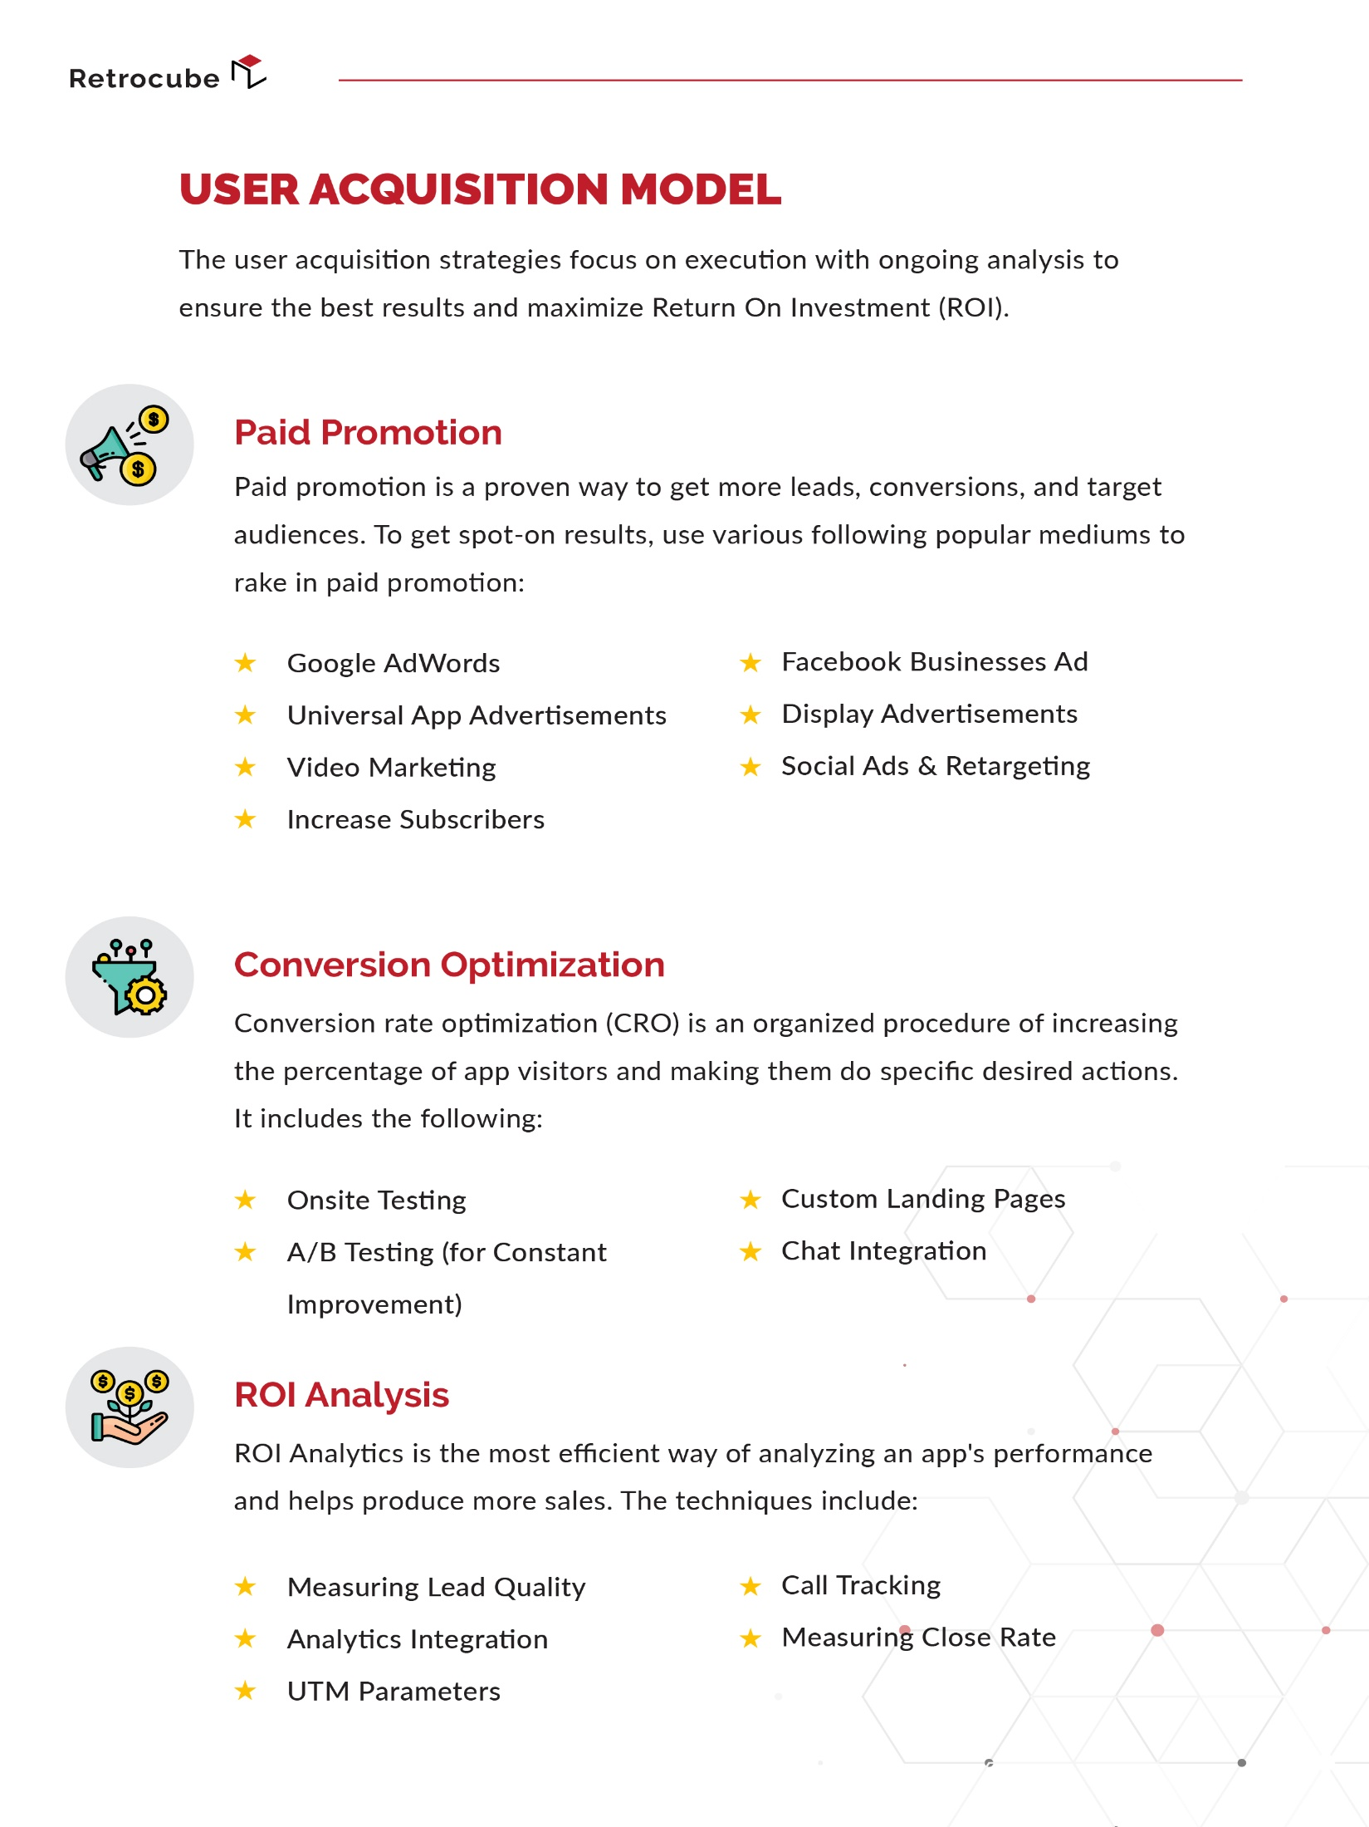

Slide 18
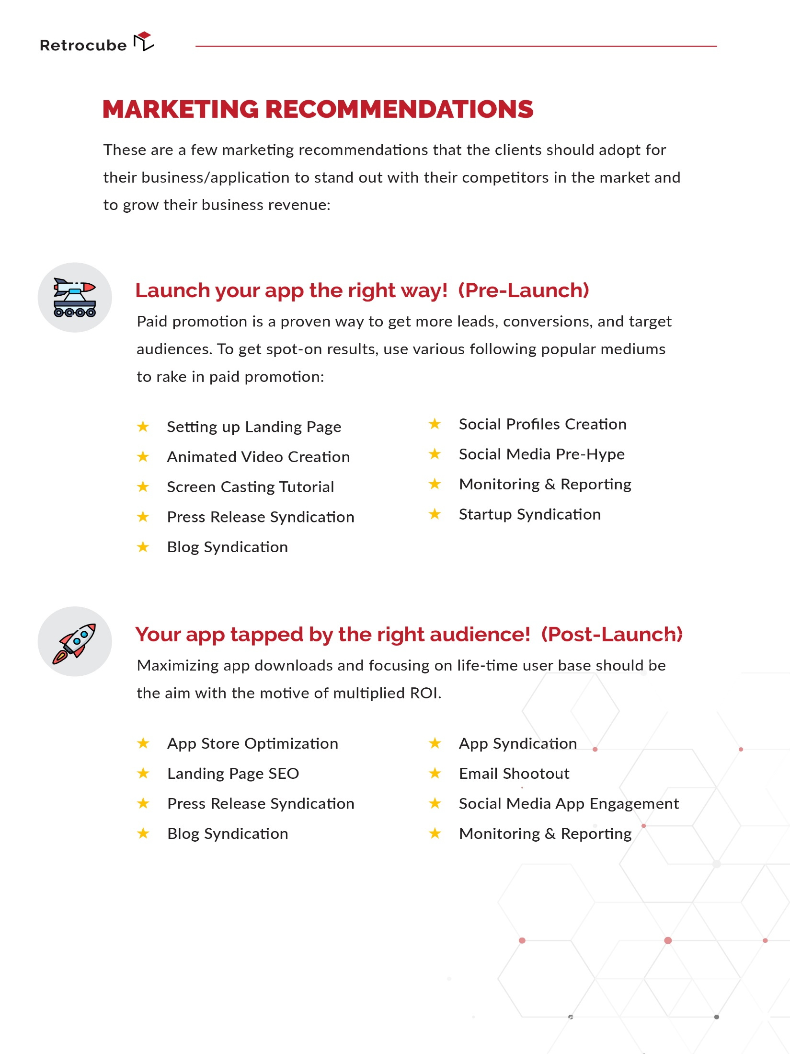

Slide 19
TERMS & CONDITIONS
| RetroCube is providing this quotation after a thorough comprehension of the client’s brief. If the originally stipulated scope of work differs from what is really required, RetroCube reserves the right to propose revised costs, even after the formalization of the contract.
| The project design and development will commence once the final Specifications document is reviewed and approved by the client.
| The provided production schedule is just an informed estimate. While we will invest our maximum efforts in making sure that all timelines are adhered to, unforeseen delays in the digital production should be kept in mind and RetroCube will not be held responsible for such.
| The provided costing estimate is exclusive of photography, music, stock images, or any out-of-pocket costs incurred during the development of the project.
| Until the client signs an official “Purchase Order” or “Cost Estimate” and makes good on any initial payments as agreed on, the project will not commence.
| RetroCube will not be held responsible in the event that any payment delays on client’s end affects the overall timeline of the project.
| Any revisions requested by the client, falling outside the original scope of work as defined by the client, will be added as change requests to the overall estimate of the project and can have an impact on the project timeline. The same applies to altering past-approved dates and deadlines.
| The proposal pricing excludes any domain registration, hosting, or license fees. However, we can connect you with a credible hosting partner, should you wish to discuss further on this matter with your designated account manager.

Slide 20
TERMS & CONDITIONS (Continued)
| If at the completion of the project, additional work has been requested by the client falling outside of the project scope, RetroCube will go ahead with the original project scope first before determining a revised payment plan and starting with the added work.
| If the estimated time period for technical-testing, proofreading, and quality assurance is affected due to a change of scope requested by the client, the project timelines and deadlines of deliverables may have to be altered. However, if the client chooses to go ahead with the project without a comprehensive testing phase, all change requests by the client after the launch will be subject to the availability of resources and charged additionally by RetroCube.
| In the event a project is inactive for a period of 30 days or more, RetroCube reserves the right to re-quote the client for the entire project or to cancel the project without any refund.
| This proposal pricing is valid for 30 days from date of issue. Should the client wish to approve after this period, it would be subject to changes in costing and timelines.
| During the support period, RetroCube will acknowledge and receive any issue reported by client and will perform all necessary measures to mitigate it. However, the issues only cover bugs and malfunctioning of the function/procedure which can be proved as bug with respect to original application scope, proposed solution and final signed off product by client and it does not cover any effort which is required to analyze, develop and implement a new requirement or a change in existing developed product.

Slide 21


